Slide 2
“So You Think It’s Your Chance?”
Exploring a Pre-Law
Career Path
Linwood Webster

Slide 3
Agenda
Welcome/Introduction
Background
Vision (Journey)
Takeaways
Q&A

Slide 4
Agenda
Welcome/Introduction

Slide 5
PUSH-IN

Slide 6
Your Race
Your Pace

Slide 7
WELCOME

Slide 8
“So You Think It’s Your Chance?”
Exploring a Pre-Law Career Path

Slide 9
Linwood Webster
Assistant Director
of Health and Law
Professions Advising

Slide 10
A Mover
A Shaker
A Change Agent
Risk Taker

Slide 11
Agenda
Welcome/Introduction
Background

Slide 12
Background

Slide 13
Education
UNC-Wilmington, Wilmington, NC
Ed.D. - Higher Education Leadership – May 2026
NC State University, Raleigh, NC.
M. Ed. Counselor Education Program –
Clinical Mental Health – May 2017
Duke University – Graduate Studies – Public Policy
post-graduate studies Fall 2015
University of North Carolina at Chapel Hill, NC.
post-graduate studies Spring 2004
Harvard University Grad. Sch. of Ed., Cambridge, MA
post-graduate studies Spring 2003
University of North Carolina at Chapel Hill, NC.
M.S. Information Science May 2002
Durham Technical Comm. College, Durham, NC
Microcomputer Curriculum 08/1994 – 05/1995
North Carolina Central University, Durham, NC.
B.A. English (Media/Journalism) 1991

Slide 14
Professional
Academic Advisor-18+ yrs.
Career Coach-18+ yrs.
Clinical Counseling-15+ yrs.
STEM Field-30+ yrs.
2-yr., 4-yr., HBCU, HWI, Public/Private

Slide 15
Professional
Over 18+ yrs. of advising ALL students, ALL Majors at UNC Chapel Hill
Over 18+ yrs. of advising students on Law School pathways
Sent UNC Chapel Hill students to UNC Law School to take classes until renumbering of class occurred**

Slide 16
Agenda
Welcome/Introduction
Background
Vision (Journey)

Slide 17
Vision

Slide 18
Exploring
a Pre-Law Career Path

Slide 19
“First
Steps”…

Slide 20
Top 10 Law
Yale
Stanford
University of Chicago
Columbia University
Harvard University
University of Penn
New York University (NYU)
University of Virginia
UC Berkley
University of Michigan
#11Duke University
#25 UNC Chapel Hill

Slide 21
“So You Think It’s Your Chance?”

Slide 22
@ College
First Year – Do I Fit/Do I Belong?
Sophomore Year – Is NC State Really The Place For Me?
Junior Year – Will NC State be
Worth It? Am I Doing Enough?
Can I Make It?
Senior Year – Did I Do Enough?
Was It Worth It? What’s Next?

Slide 23
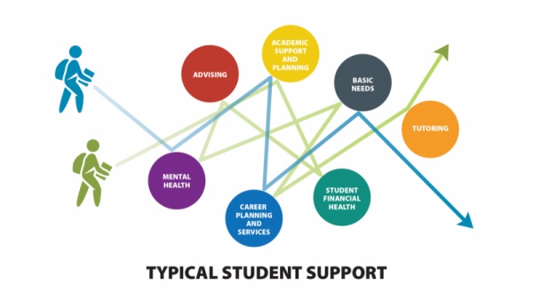
Disjointed and Disconnected
Silo & Tunnel Vision

Slide 24
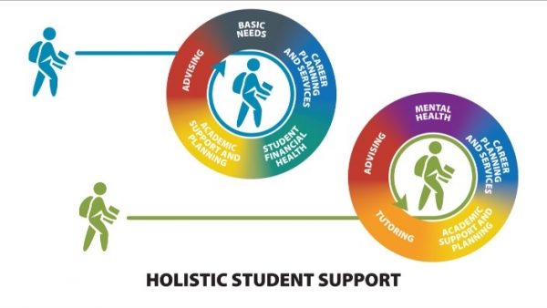
My Professional Work

Slide 25
Professional
Academic Advisor-18+ yrs.
Career Coach-18+ yrs.
Clinical Counseling-15+ yrs.

Slide 26
Student-Centered
Academic
Advising
Baseline
Clinical
Counseling
Holistic
Approach
(Anxiety)
Career
Coaching
Combined Academic Affairs and Student Affairs Model

Slide 27
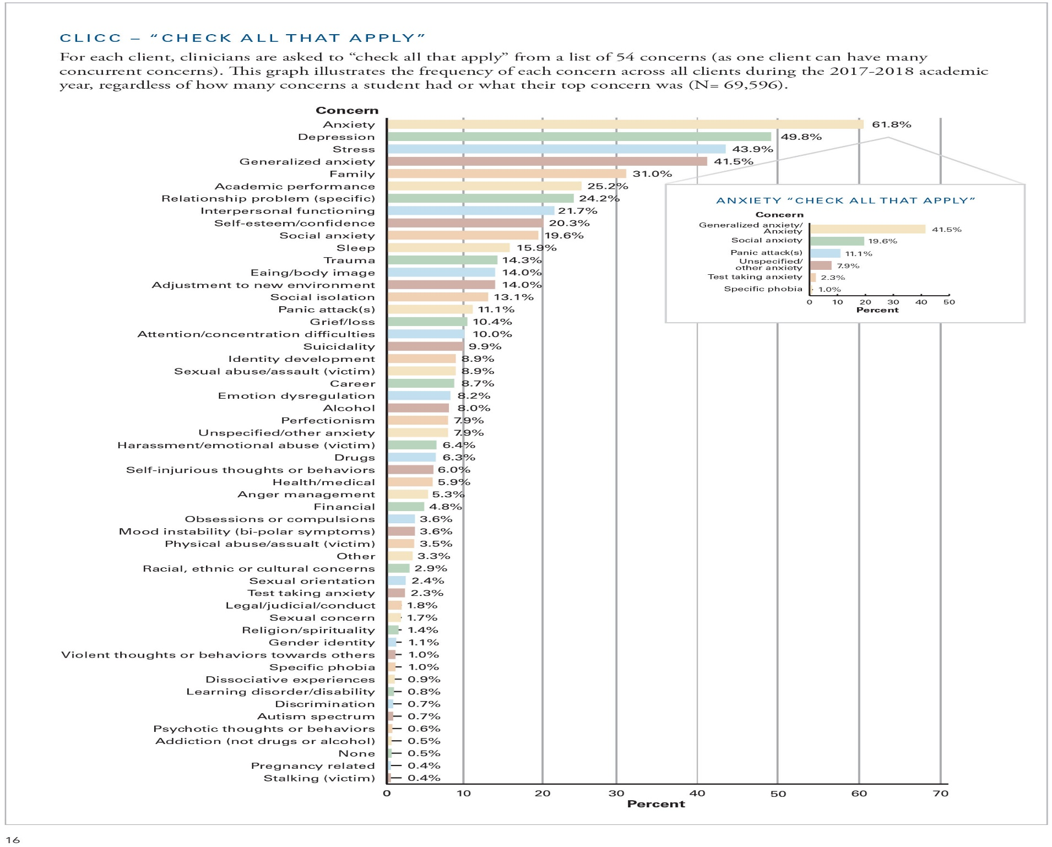

Slide 28
What I Offer
Unpack
Pre & Post-
Graduation
Anxiety!
Work/
Internship
Wellness
Family
Tuition
Family
=
Wellness
Social
Distance
Life
Classes
Tuition
Work
Classes
Life
Campus
Life
Social
Distance
Pandemic-
Crisis
Campus
Life
Pandemic
post-Graduation plans LAW SCHOOL

Slide 29
Pre-Law Resources
Applying to law school
Law School Admissions Council (LSAC)
Law School Locator
The LSAC Law School Locator gives you an idea of what schools you are most likely to be accepted into based on your GPA and LSAT score.
Test Prep
LSAC: LSAT Prep Tools –
Khan Academy –
Princeton Review, Kaplan, ExamKrackers, PowerScore.
What is Ideal Profile?
What are Desired Major(s)?
What Should Transcript Look Like?

Slide 30
Pre-Law Resources
There is no prelaw major at ​NC State. Any major is fine as long as it is academically rigorous. As a prelaw student, you should have certain goals for your undergraduate education -- you should acquire good oral and written communication skills as well as good listening skills, you should learn to think analytically and critically, and you should learn to read and synthesize large amounts of materials.
Whatever major you choose, challenge yourself. If possible, take a full course load each semester and attempt to earn honors.
Take a law-related courses here at NC State > @Duke(FREE), @UNC, and
@ NC Central University(criminal justice). These courses can be found in various departments such as, but not limited to English, Communication, History, Philosophy, Political Science, and Public Policy.

Slide 31
Pre-Law Resources
No significance on double majors or if you have a minor.
Academically rigorous courses and do high-quality work.
Studying abroad for a semester or a year will not greatly affect your chances of admission to law school. Law schools are, however, interested in students who have diverse educational backgrounds. Additionally, bilingual attorneys often have a competitive edge. If you plan to study abroad, do so at a reputable program that is academically rigorous. Volunteer, Shadow, Observation opportunities abroad.
Working for a lawyer or similar legal experience may be useful in assessing your interest in being a lawyer, but in general will not significantly affect your chances of admission to law school. MAKE A DIFFERENCE!!
Law schools do look favorably on leadership skills and community service in their applicants. You should not participate in an activity just for your resume, but instead become involved in an activity because you have a true interest in it. Aim for quality over quantity. Making real contributions to just one or two organizations is much more meaningful than superficial affiliation with many groups.

Slide 32
@ College
Major/ Minor combinations (3)
Interdisciplinary Studies Major (3)
Interinstitutional enrollments –Duke/UNC-Chapel Hill/NC Central*
Honor Classes as non-Honors student
NC State Career and Professional School Fairs – (6-8)
Career and Professional School Fairs – Duke/UNC*
Create Pathways into Duke, NC Central, & UNC Law Schools
Entrepreneur (Shark Tank) Competition Opportunities
Student Groups, Student Clubs, & Student Organizations
Internships each Summer – shadow, “sit-in”
Graduate classes – UNC & Duke
Gap Year Prep – Research, Professors, & Portfolio
References/Resources – 2-6 Professors
“Self-placed” challenges – like Study Abroad,
Internships Abroad, Undergrad. Research, Indep. Studies, TA’s, Volunteer at El Centro, Service Learning Opps.

Slide 33
Comfort Zone
Socially
Intellectually
Personally
Professionally
Educationally

Slide 34
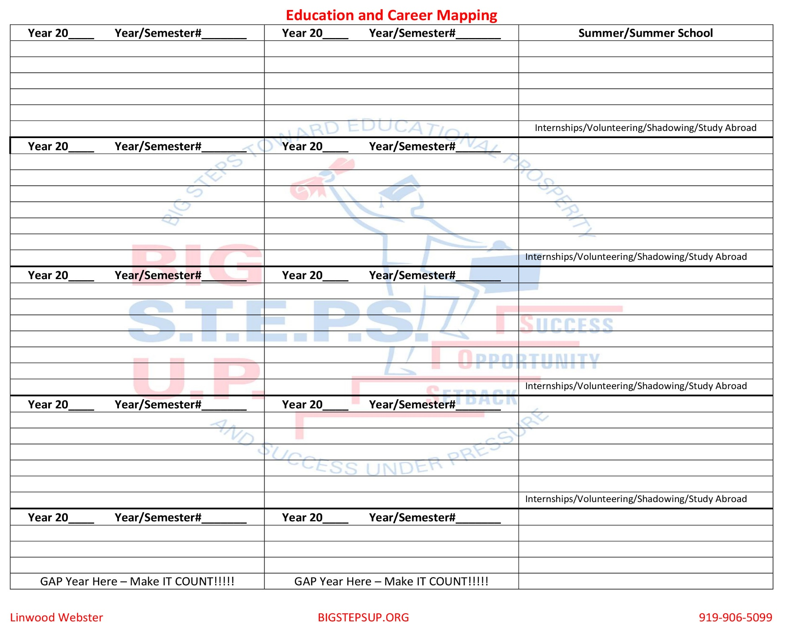

Slide 35
Agenda
Welcome/Introduction
Background
Vision (Journey)
Takeaways

Slide 36
Takeaways

Slide 37
Takeaways
“Always Open Door/Empty Chair”
18+ yrs. of Law School Pathways
It Takes More Than A Major (Global)
Education vs. Degree
Digital Portfolios/Gap Year Portfolio
Value <-> Virtual
Senior Bridge Workshop
Visioneering

Slide 38
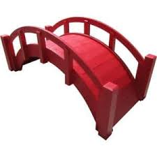
Senior Bridge Workshop!

Slide 39
Senior Bridge Workshop! “When The Shift Hits The Pan(demic) - Are you Socially, Academically, Financially, and Emotionally (S.A.F.E.) Prepared for Health/Law School, & Life Successes?”

Slide 40
Visioneering

Slide 41
“The Only Thing Worse Than Being Blind Is Having Sight and No VISION.
Helen Keller

Slide 42
Top 10 Law
Yale
Stanford
University of Chicago
Columbia University
Harvard University
University of Penn
New York University (NYU)
University of Virginia
UC Berkley
University of Michigan
#11Duke University
#25 UNC Chapel Hill

Slide 43
“So You Think It’s Your Chance?”

Slide 44
Q&A
Linwood Webster
Lwebste@ncsu.edu

Slide 45
END
END
END
END

